Slide 1
Home page
Add “over 830”

Slide 2
Become a member page
Link this line with the pdf shared in the mail
The buttons are not working

Slide 3
Home page
Link the impact initiative with the impact page

Slide 4
Home page
Just make it “ACT” – also link the tab with - https://www.digitalact.in/

Slide 5
Office bearers page
Both of their images and details will inter change
Image shared in the mail

Slide 6
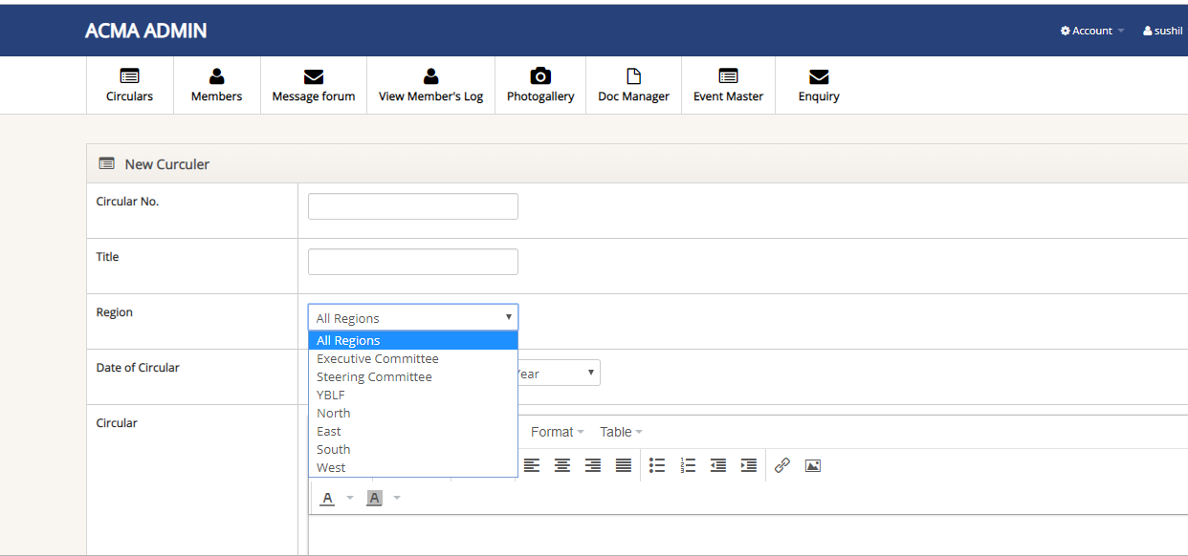
CMVR Regulations
Eastern Region
Executive Committee
Government Policy Matters
Knowledge Partner Reports/ Industry Statistics
National Events
Northern Region
Overseas Events
Southern Region
Steering Committee
Western Region
Add all these and only these categories in the region tab

Slide 7
Need to add 1 more filter here as “Categories”

